Slide 1
A Walk-Through Silicon Valley
How an English Major Survived 40 years in Silicon Valley

Slide 2
Agenda
Background on me
Rules for Product Management
Overview of TidalScale
Lunch

Slide 3
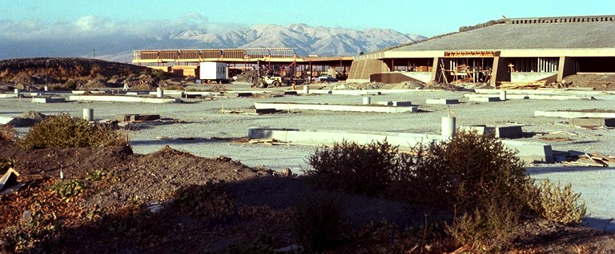
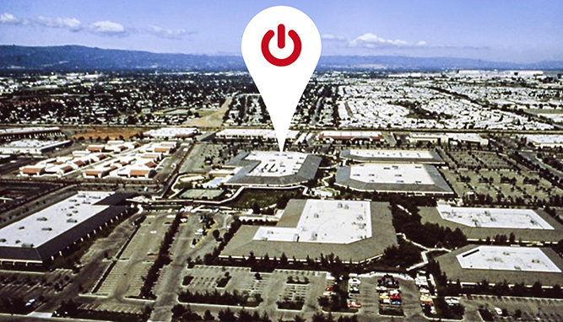
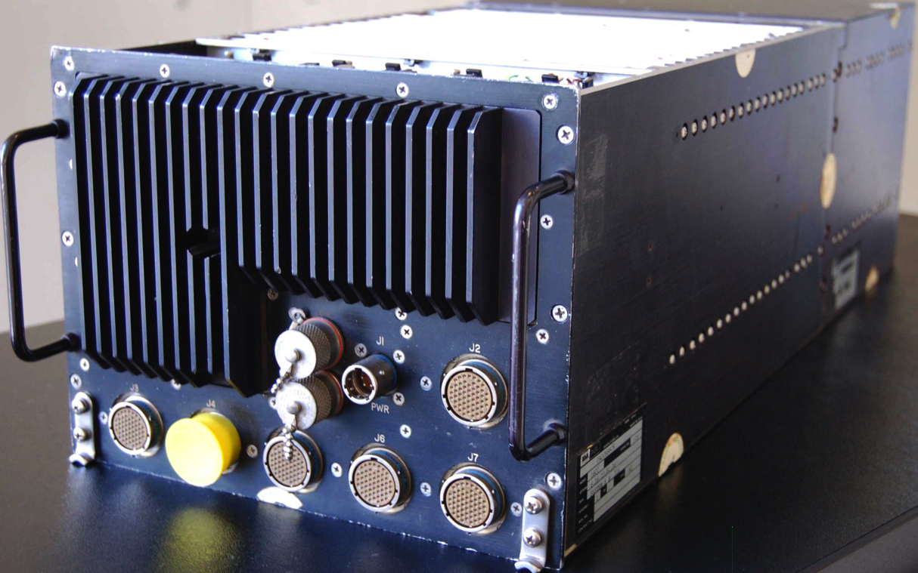
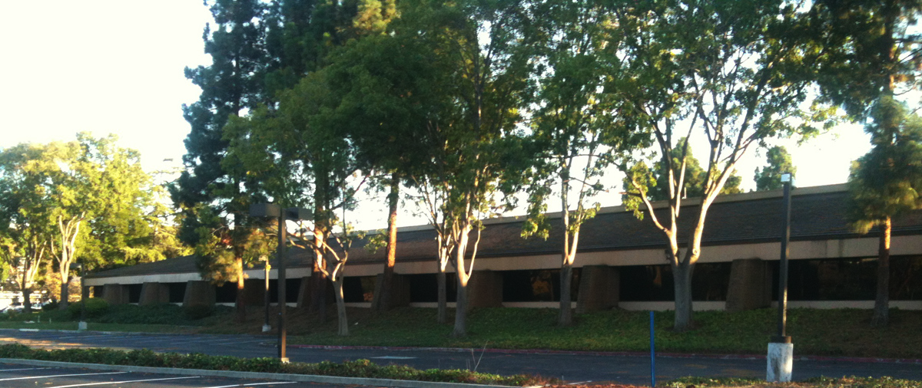

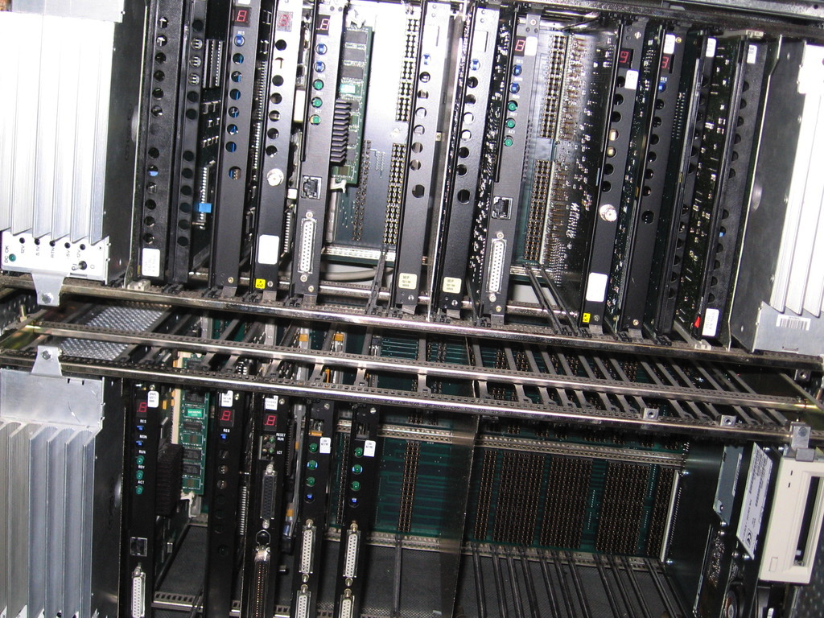
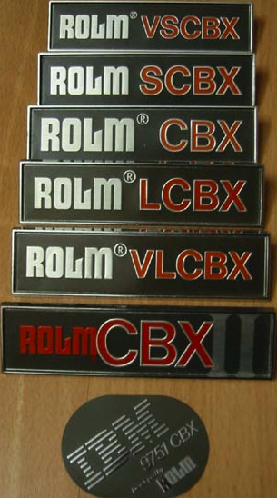
A Story about a Parking Lot

Slide 4
Agenda
Background on me
Rules for Product Management
Overview of TidalScale
Lunch

Slide 5
12P’s
Ingredients for Going To Market
Tom Miller
Chuck Piercey

Slide 6
Do you know a super-talented team of engineers that built awesome software yet failed to get it used?

Slide 7
Heard inside the engineering driven software company
“Code’s done. Ship it.”
“The eval download is the sales process.”
“If there’s a problem, the source is on github.”

Slide 8

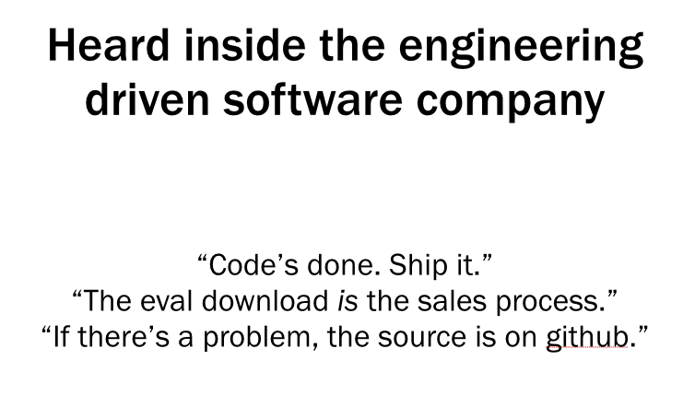

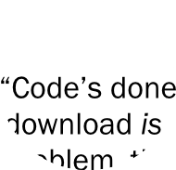
OK, you caught me
No self-respecting software developer has ever said the code is done.
But…

Slide 9
Code is < 50% of the product you deliver to your customers

Slide 10

Jam isn’t much good without a jar

Slide 11
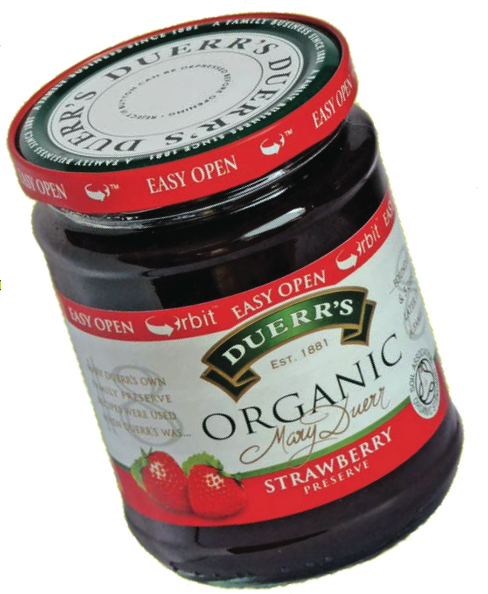
Software isn’t much good without the 12P’s
Purpose
Profile
Pain
Position
Product
Pricing
Placement
Partners
Promotion
Proposition
Performance Metrics
Plan
e.g. “PBJ” jam application deployment requires a jar, knife, bread, cutting board…

Slide 12

Classic Product Management
The Four P’s
Product
Pricing
Placement
Promotion

Slide 13



You have no time to go back to college to study marketing
Anyway, you’re an engineering driven operation and can’t throw too much money down the marketing and sales rat-hole
So, 13P’s is a checklist of things you need to be thinking through before and during your product introduction

Slide 14
Purpose
Purpose
Profile
Pain
Position
Product
Pricing
Placement
Partners
Promotion
Proposition
Perf Metrics
Plan
What is the strategic goal that the business needs to achieve?
What is the business mission?
Are their any resource or strategic constraints to be considered?
Are there complementary/adjacent business initiatives to consider?
What is the core differentiator of the company?

Slide 15

Profile
Purpose
Profile
Pain
Position
Product
Pricing
Placement
Partners
Promotion
Proposition
Perf Metrics
Plan
Who uses it?
Who buys it?
How can you divide up your market into manageable segments?
How many potential customers are out there?
Where do they hang out?
How do you recognize a prospect when you see one?
Where do you go first? Biggest pain? Risk tolerance?
What will they pay?
What other options, alternatives do they have?

Slide 16
Pain
Purpose
Profile
Pain
Position
Product
Pricing
Placement
Partners
Promotion
Proposition
Perf Metrics
Plan
Customer’s current situation?
How do they suffer? How do they measure the pain?
What is the value of fixing the problem? Cost of not dealing with it?
What are the trigger points to taking action and buying?
What are the barriers to that action?
Can they afford to take action?
If they’re not feeling pain, you won’t gain.

Slide 17
Position
Purpose
Profile
Pain
Position
Product
Pricing
Placement
Partners
Promotion
Proposition
Perf Metrics
Plan
Enumerate your competitors and customer’s alternatives
Identify distinguishing/unique characteristics of your offer.
Characteristics should be a feature/benefit pair.
Must map to the customer pain points you’ve identified
Are there worse pain points for the customer than those solved here?
Lifespan of your solution? Short-term? Long-term? Dead-end?
Roadmap: can you articulate an evolution of the product that addresses adjacent pain points or problems? What green pastures lie ahead?

Slide 18
Product (actually 2)
Purpose
Profile
Pain
Position
Product
Pricing
Placement
Partners
Promotion
Proposition
Perf Metrics
Plan
Whole Product:
Clearly defined benefits from using your product
What features does the product contain that deliver this benefit?
Clear definition and specification of the product, related service and support
Whole customer experience:
Should also be conscious of dependent external components i.e. Batteries not included
Make it easy to find batteries, if you can’t supply them yourself
How is the product used by your customer? Who are the beneficiaries? (hint: might not be the direct users)
Pricing, licensing, business terms.
Aspire to be frictionless. “Any job that’s easily accessible is nearly done.”

Slide 19
Pricing
Purpose
Profile
Pain
Position
Product
Pricing
Placement
Partners
Promotion
Proposition
Perf Metrics
Plan
Can you sustain a price that supports long-term investment in the product?
And still provide customer benefit and ROI?
Try to build a back-of-the-envelope Return-on-Investment analysis
Keep discounts simple - how much time and mental energy do you want your customers to spend on this, when they’ve decided to buy?
Be conscious of how your customer might use the product. Take care not to make too many assumptions (especially if it’s a development platform)
Pricing architecture - atomic, accessible, adaptable
It will change.

Slide 20
Placement
Purpose
Profile
Pain
Position
Product
Pricing
Placement
Partners
Promotion
Proposition
Perf Metrics
Plan
Who sells the product? Which channels?
Who are the buyers in the supply chain? (may be multiple steps)
Where are you likely to be seen by buyers, users?
What is the typical timeline to close a sale?
Identify specific, concrete steps/milestones
How do you stay present with buyers, users, during the sales process?
What are the resources needed to support a sale?
How do you deliver, once sale is done? Support initial use and deployment?
Clearly set expectations about delivery: what customer receives, when?
Customer on-boarding process? Training and support access? Community resources?

Slide 21
Partners
Purpose
Profile
Pain
Position
Product
Pricing
Placement
Partners
Promotion
Proposition
Perf Metrics
Plan
Are third-party components required?
Make them easy for your customers to find.
Take care to minimize share-of-wallet competition. Avoid deal-chaining.
Is there a third-party that adds credibility or connections to your target audience?
Should these complementary products be bundled? Or referrals?
Do you plan to replace these partners with your own offer?
Complementary revenue opportunity?
What other suppliers/vendors or influencers touch the customer as part of the typical sales cycle?
Will these partners align and cooperate?
Who owns the partner relationship and confirms the fit and alignment to your product offer?
Are the respective support organizations connected, aligned, cooperative?

Slide 22
Promotion
Purpose
Profile
Pain
Position
Product
Pricing
Placement
Partners
Promotion
Proposition
Perf Metrics
Plan
Have an elevator pitch always ready:
For [people | organizations] who have [describe problem], we provide [solution description]. Because of our [unique value proposition] we enable you to [beneficial result].
Messaging that’s concrete, fact based. Avoid hyperbolic words:
“best”, “amazing”, “revolutionary”, and other B.S. …
Launch Checklist
☑︎PR
☑︎Lead Customer reference
☑︎Advertising? Adwords?
☑︎Community outreach
☑︎Partners trained
☑︎Whitepaper
☑︎Webinar, Quickstart Training
☑︎User Conference
☑︎Industry Conference
☑︎Prospect/lead attack lists

Slide 23
Proposition
Purpose
Profile
Pain
Position
Product
Pricing
Placement
Partners
Promotion
Proposition
Perf Metrics
Plan
How is the business offer summed up in a proposal?
Benefits defined? Return-on-Investment asserted?
Deliverable specified?
Long term value proposition provable, measurable?
Clearly actionable closing/contracting/purchasing/receiving process?
Timeline and expiration of offer

Slide 24
Performance Metrics
Purpose
Profile
Pain
Position
Product
Pricing
Placement
Partners
Promotion
Proposition
Perf Metrics
Plan
How do we assess overall business success or impact?
What specific metrics most correlate with the desired impact?
How can we propagate non-pathological metrics into the organization?

Slide 25
Example: TidalScale Validation
383
Validation meetings or
Initial Sales presentations
19
Sales Opportunities
3477
Contacts Made
April 2013 to date
66
Current Active Prospects
5
alpha customers signed
14
Beta
prospects

Slide 26
Example: TidalScale Validation
Hot
NeoTechnology BlackArrow UCSF Digital Infuzion | UCSC Genomics Synopsis SuperMicro* (*partner)
Moderate
Avaya Objectivity GeneDrop Altilia Intel Icahn School of Med | LogicBlox MedSolutions Informatica Lockheed Martin Autodesk Royal Inst Tech-KTH
Mild
Polaris Design Syst. Broad Institute Wisconsin Med Coll. ViSiNETS, Inc. PNDLM Delta Dental | Novartis Palantir Pathway Genomics Los Alamos Labs USF
Notes:
Hot = short term and specific need identified
Moderate = can envision applications to use in their organization, or wants to make introduction to others on team
Mild = sees value and engaged in the meeting, but is either a) not a buying influence nor technical buyer or b) consultant
Developments since last report:
Added BlackArrow – actively doing perf testing with them
Digital Infuzion wants us to do intro meeting with their CEO
NeoTechnology – starting evaluation
Pricing sentiment – moved one “Not Meaningful” into the Neutral column as our sales conversations are advancing (NeoTechnology)
The 2 accounts saying “too expensive” = Icahn School of Medicine (further argument was that we should be open source and sell services), Novartis (research group) also said “too expensive” – note, was an advanced research lab

Slide 27
The 12th P: Plan
Purpose
Profile
Pain
Position
Product
Pricing
Placement
Partners
Promotion
Proposition
Perf Metrics
Plan
Integrated objectives and actions between:
Product Management
Marketing
Sales
Services & Support
IT & e-commerce team
Cross-team meetings / company wide to give everyone context

